Slide 1
The Past versus History
Notes:
The Past is everything that has ever happened
History is the meaning we give to events

Slide 2
Examining an Artifact from the Past
What feeling or sense do you get from observing it?
Are there symbols or is there writing on it?
What does this appear to be?
How/where could we research the item?

Slide 3
Does guessing tell us the story?
Notes:
Guessing does not tell the story leaving the item a thing of the Past

Slide 4
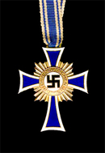
From the Past into History
Step One
Research medals and see if we find a match

Slide 5
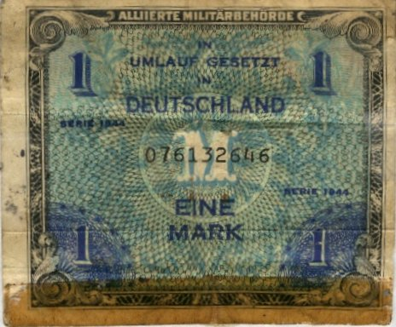
From the Past into History
Step Two
Research Laws including the Law for the Encouragement of Marriage and 1000 Mark loan
Notes:
1933 Law for Encouragement of Marriage
Newlyweds were ‘loaned’ 1000 Marks. For each child they were forgiven 25%

Slide 6
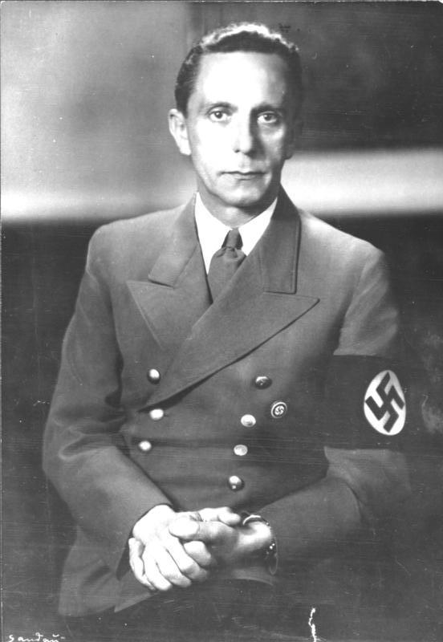
From the Past into History
Step Three
Research people and their ideas including Joseph Goebbels, the 3Ks or 3Cs, Hitler Youth, and the role of women
Notes:
Hitler Youth girls learned Kinder=children, küche=kitchen, and kirche=church
Women were to be beautiful and produce children while boys learned discipline and soldiering

Slide 7
From the Past into History
Step Four
Ask why the Nazis promoted marriage and childbirth and separate roles for males and females? What are “Lebensborn”?
Notes:
Lebensborn or “Fountain of Life” were illegitimate children of SS men and local, Aryan women. They were birthed in Lebensborn houses throughout Europe and adopted out to German families.

Slide 8
Giving meaning to an Artifact
1st Gold, 2nd Silver, and 3rd Bronze medals awarded for 8+, 6-7, or 4-5 children
Women wore the medal and were given preferential treatment
Given between 1939 and 1945

Slide 9
The transition from the Past to History
We now know:
The goal of the Holocaust and child production
Minister of Propaganda Joseph Goebbels
The 3Ks, Hitler Youth, women’s roles
Lebensborn
and have identified…

Slide 10
Cross of Honor of the German Mother
Commonly called the Mother’s Medal

Slide 11
